Slide 1

TRANSFORMATION OF FUNCTIONS
YEAR 11
BUKIT SION HIGH SCHOOL
2019-2020

Slide 2
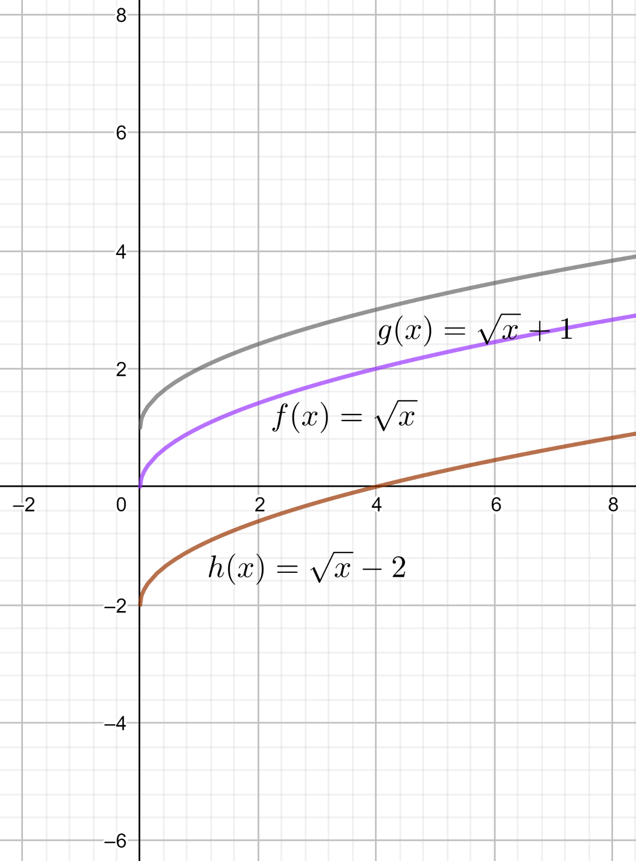
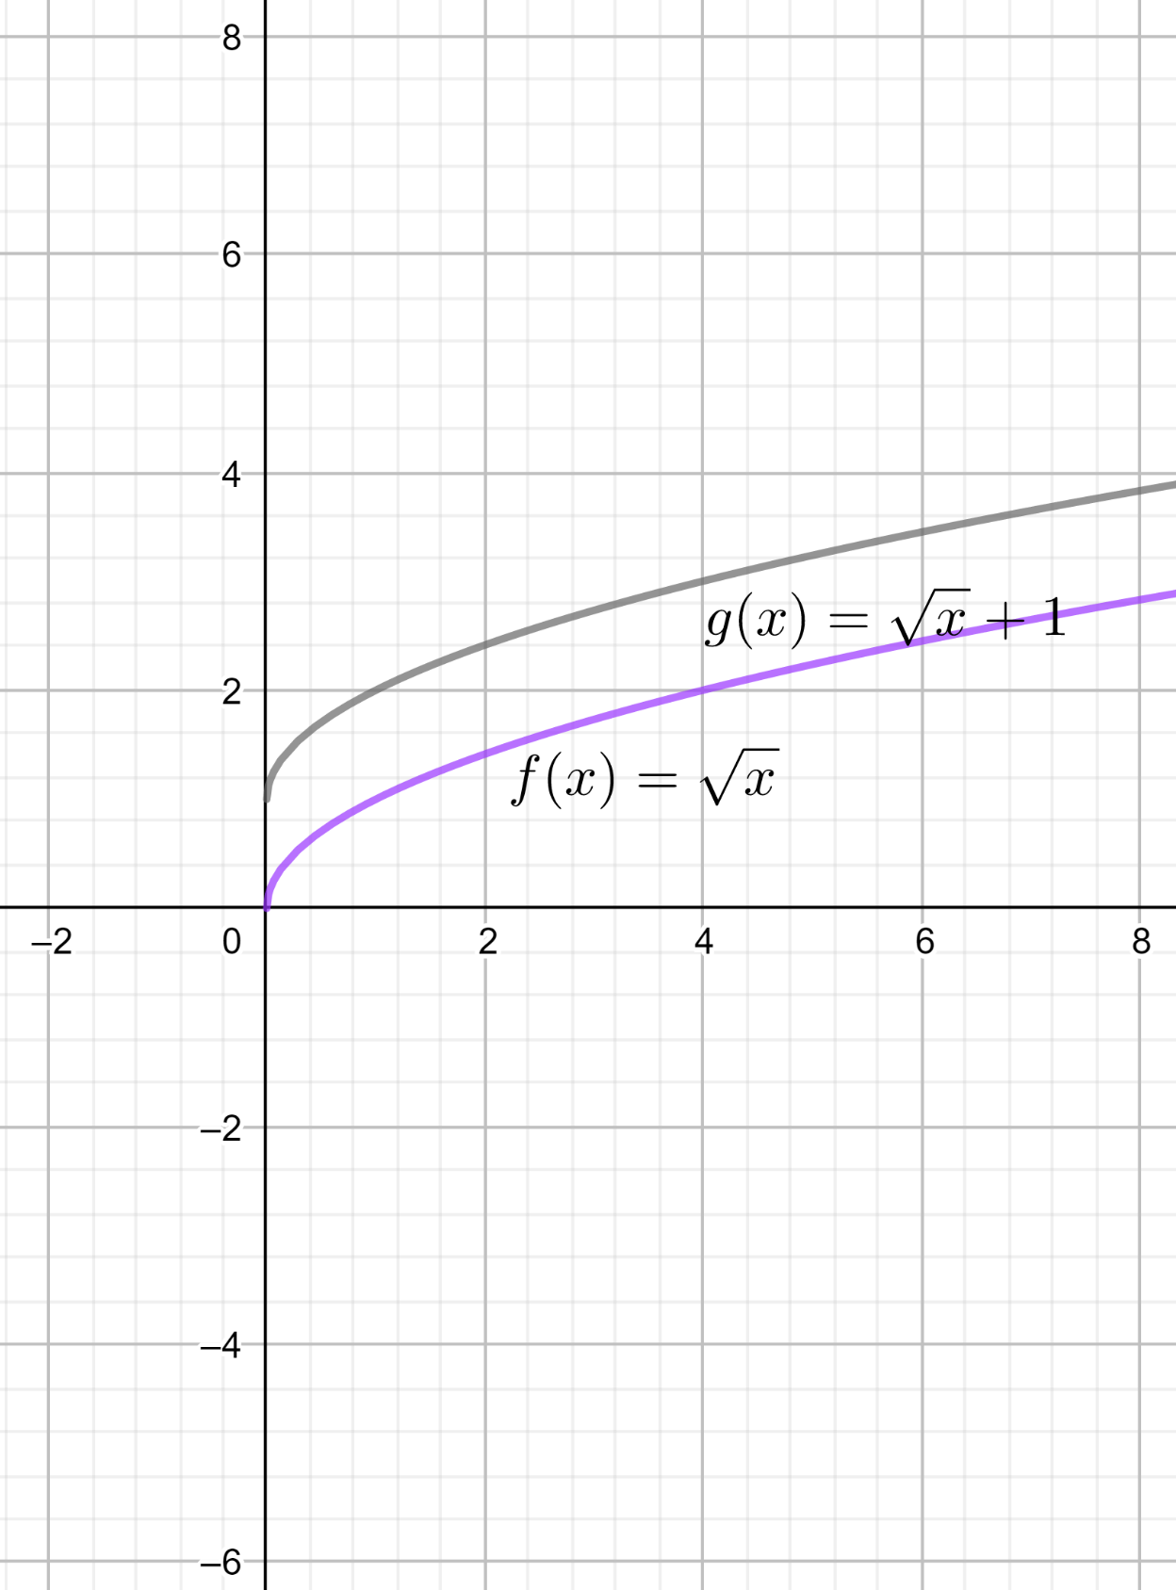
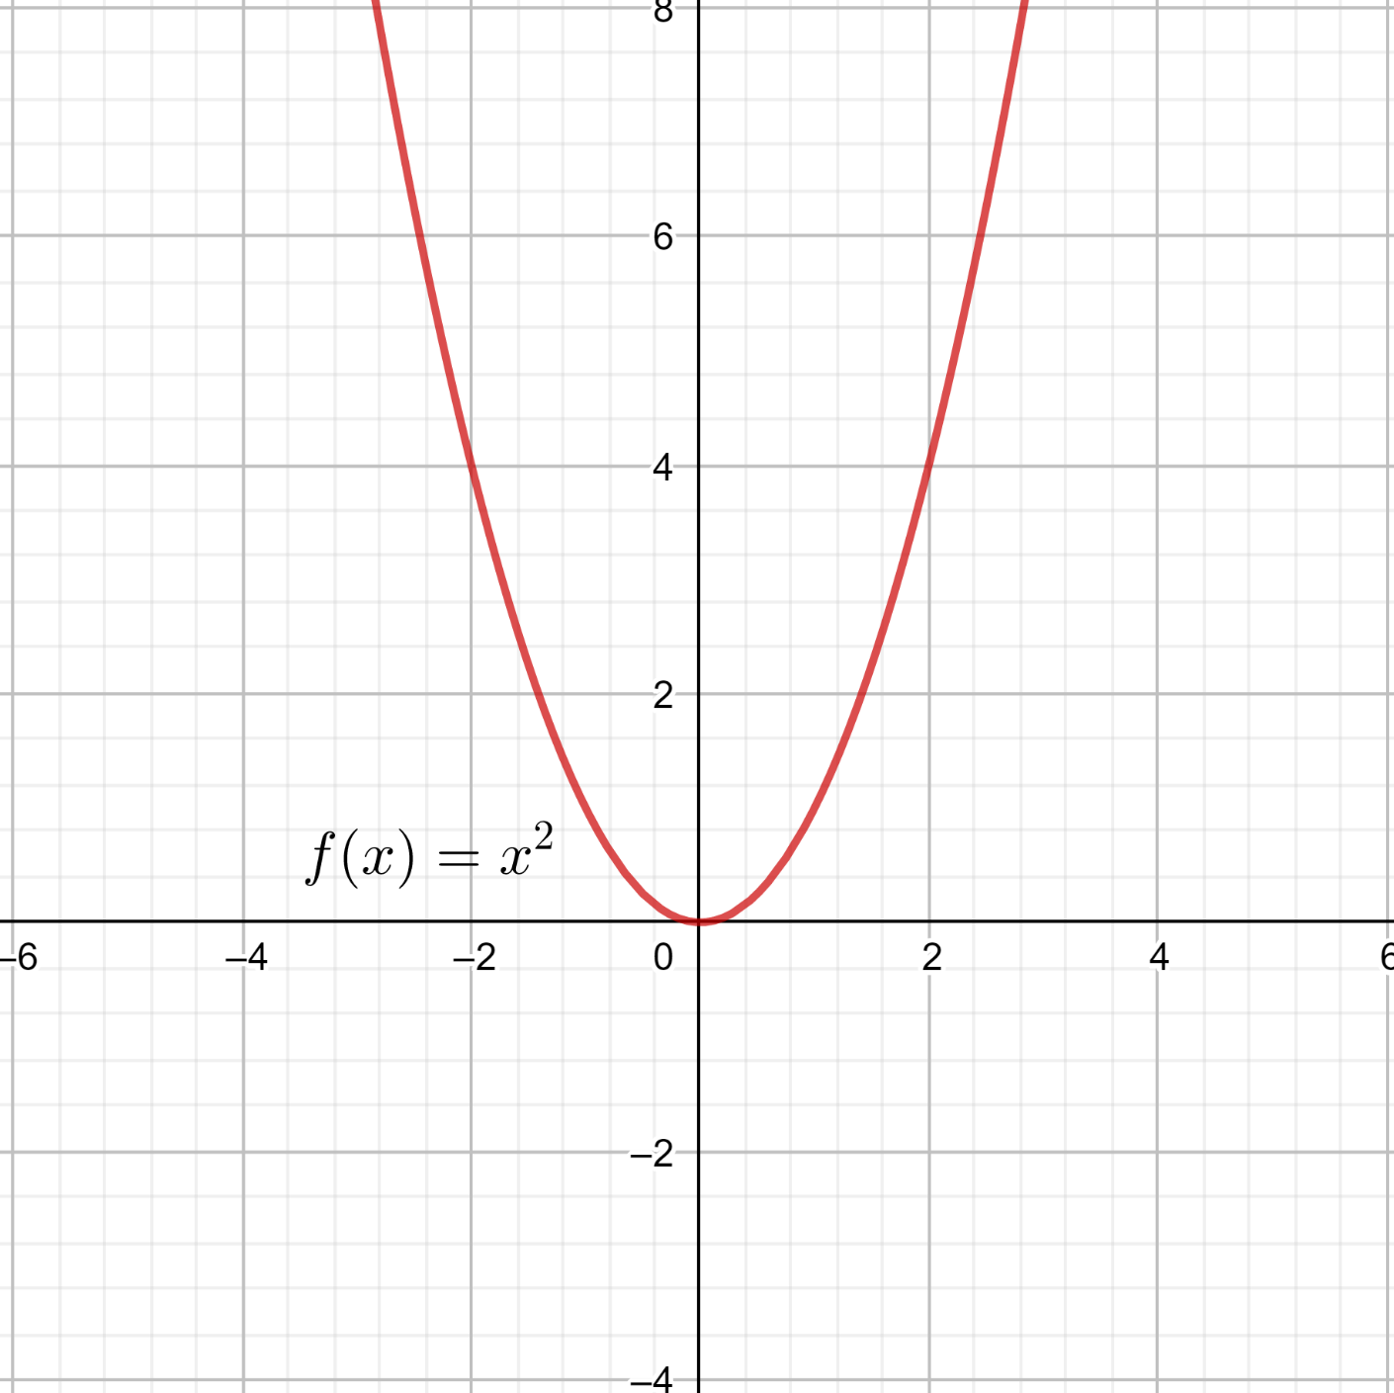
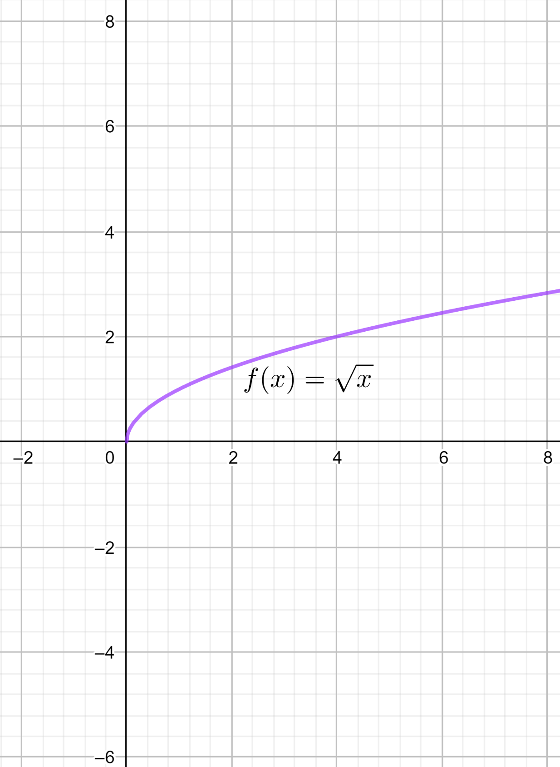
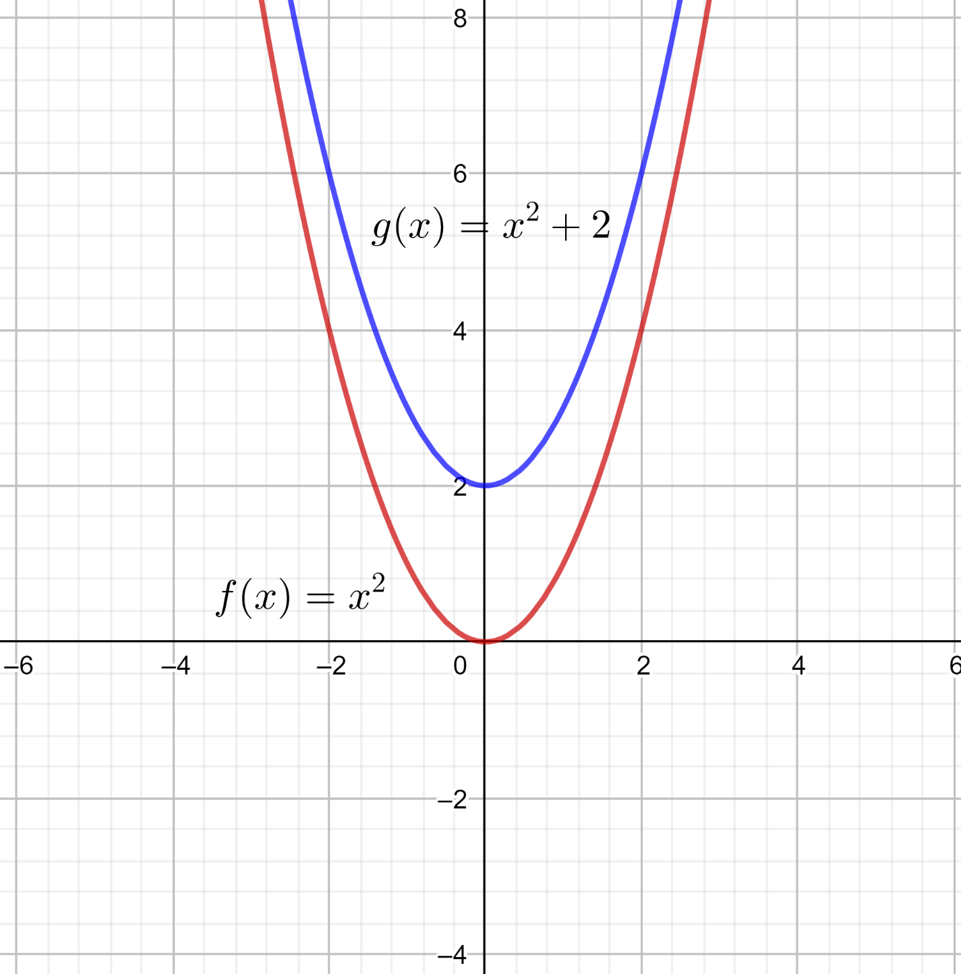
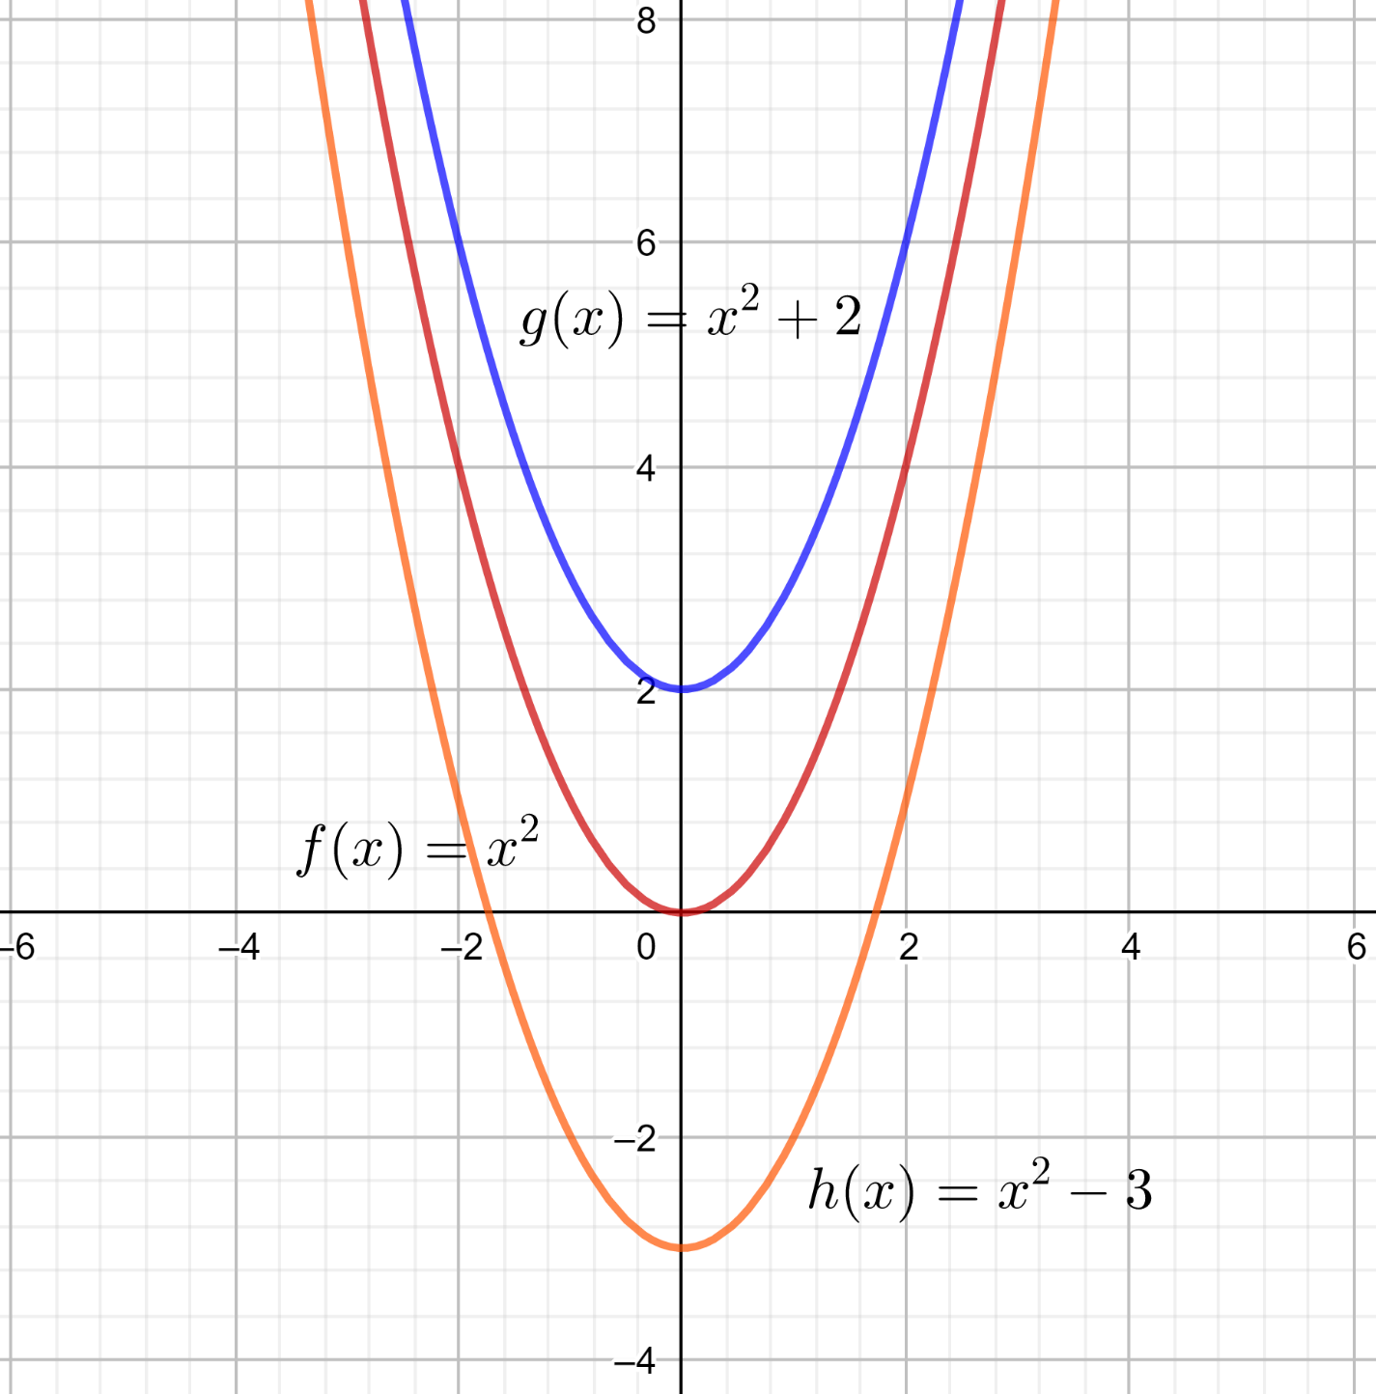
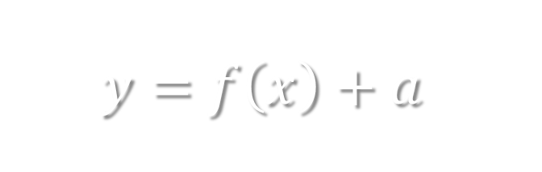
$$y=f\left(x\right)+a$$

Slide 3

Conclusion:
The graph of $y=f\left(x\right)+a$ can be obtained by

Slide 4
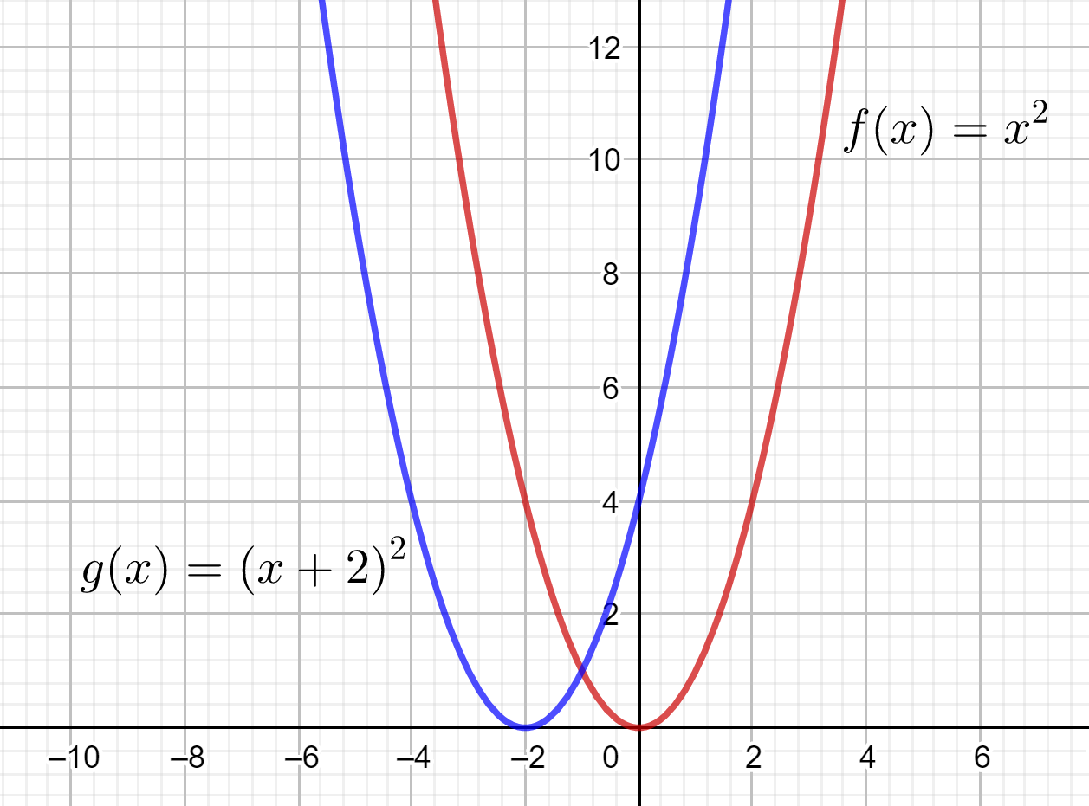
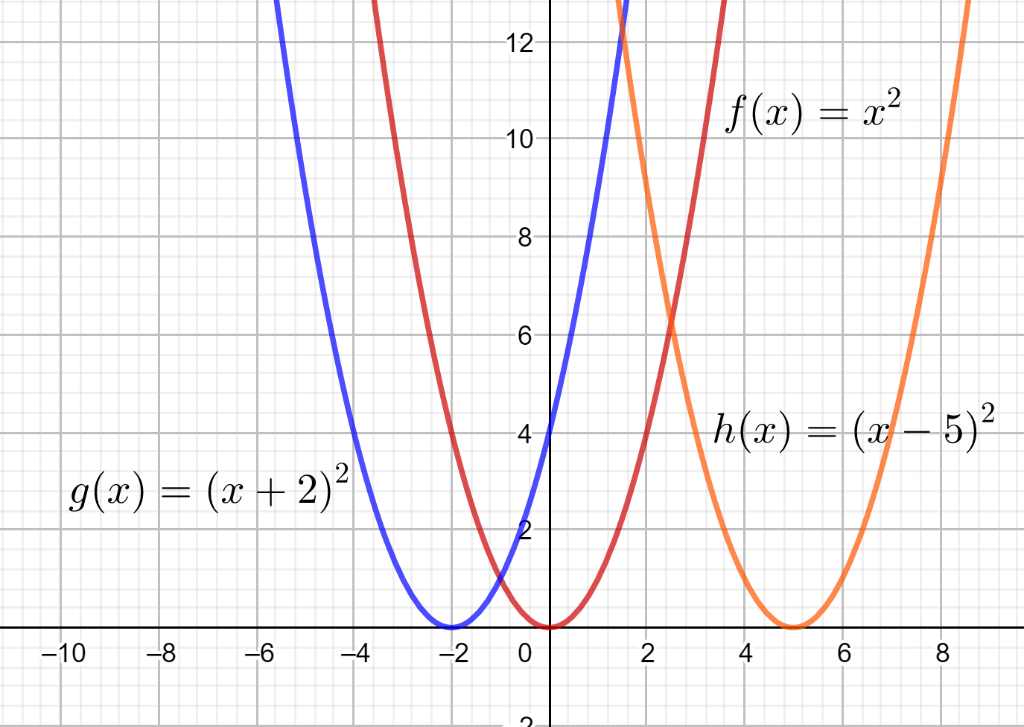
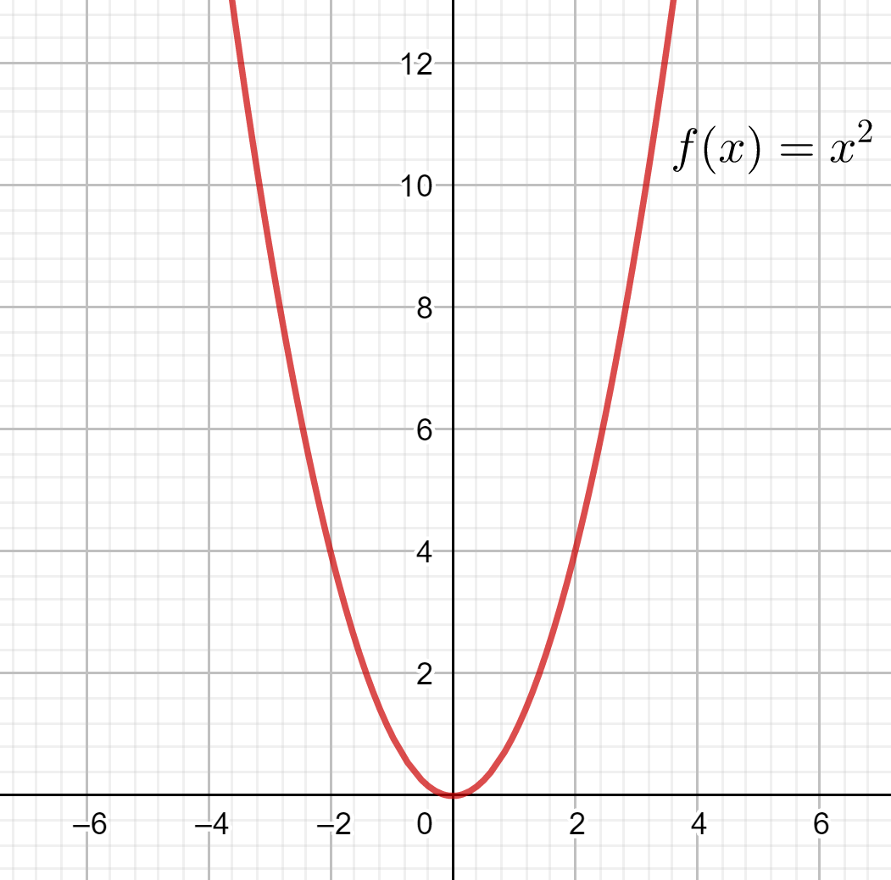

$$y=f\left(x+a\right)$$
Conclusion:
The graph of $y=f\left(x+a\right)$ can be obtained by :

Slide 5
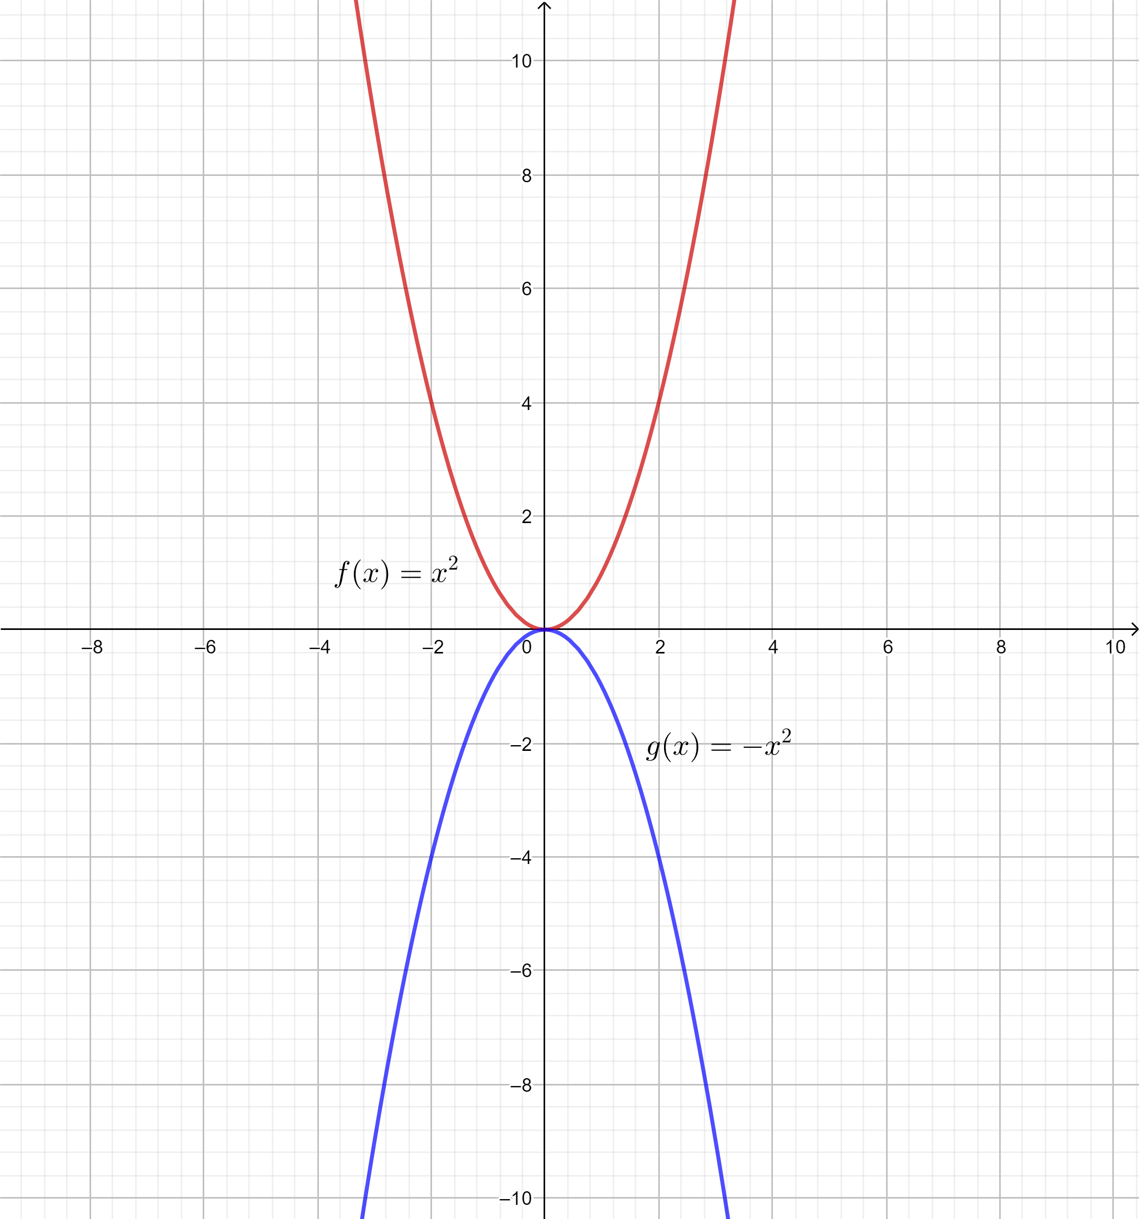
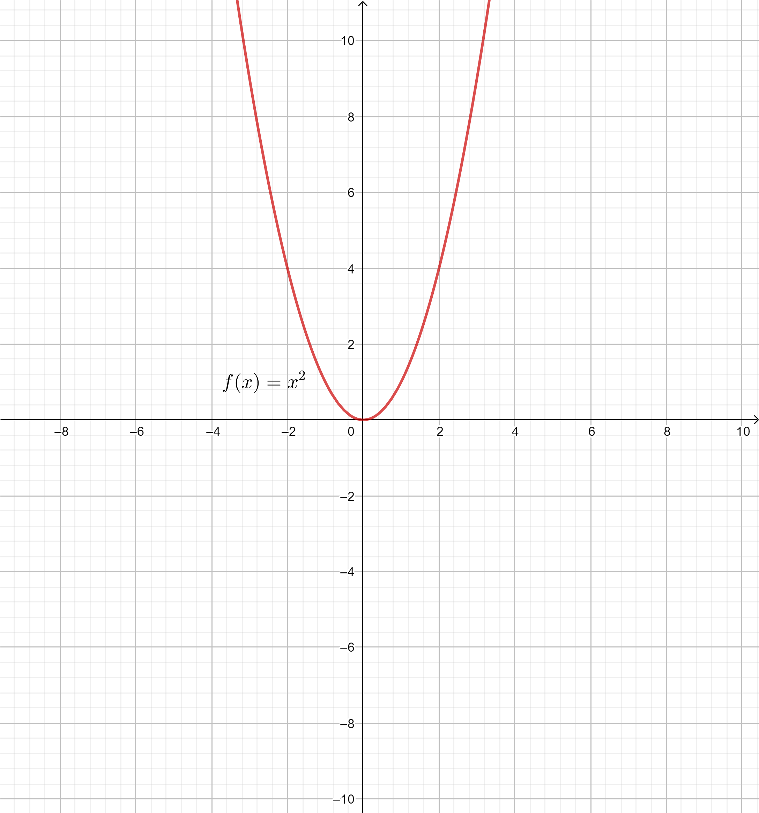

$$y=−f(x)$$
Conclusion:
The graph of $y=−f\left(x\right)$ can be obtained by :

Slide 6
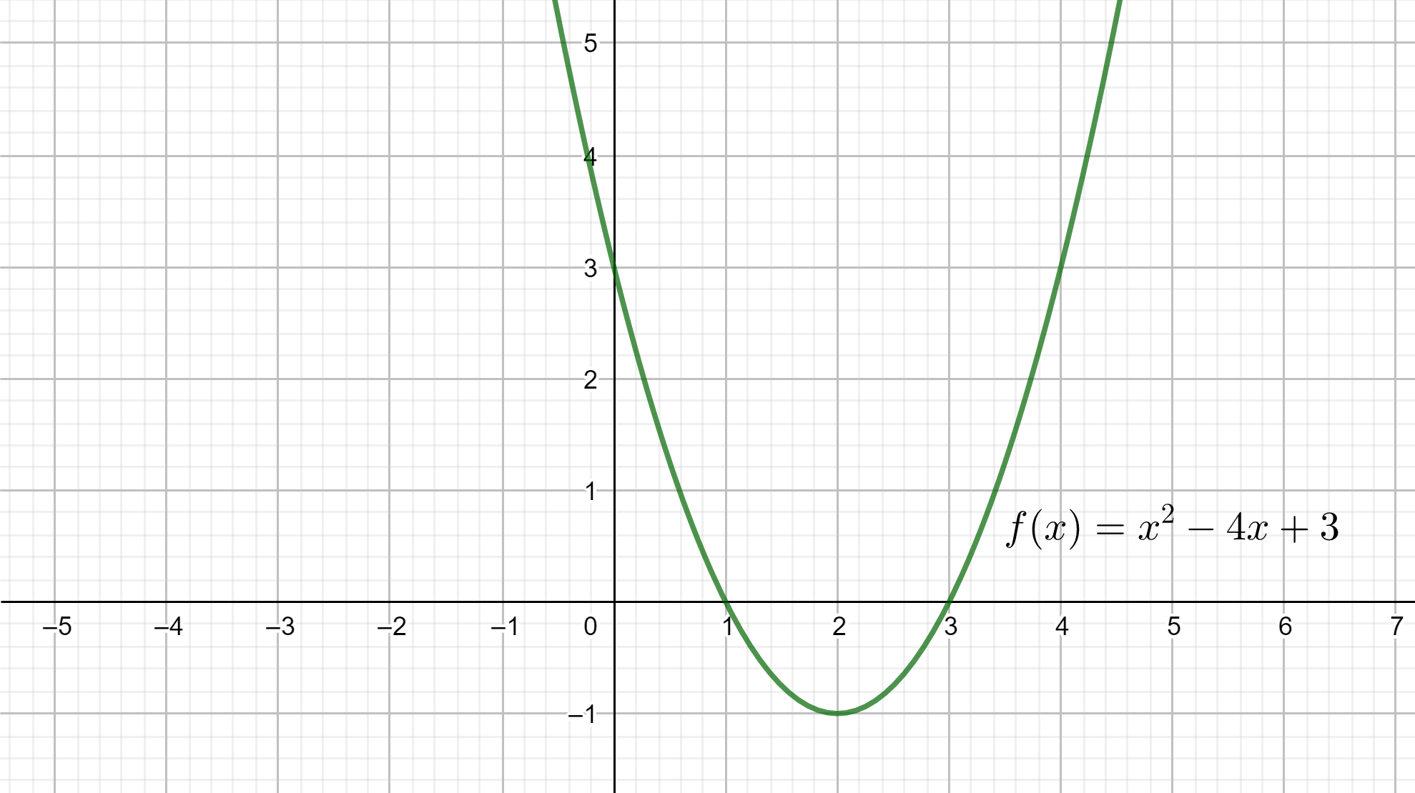
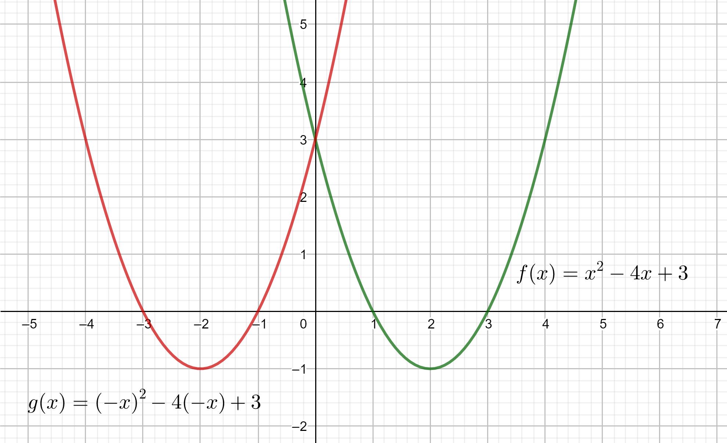

$$y=f(−x)$$
Conclusion:
The graph of $y=f\left(−x\right)$ can be obtained by :

Slide 7
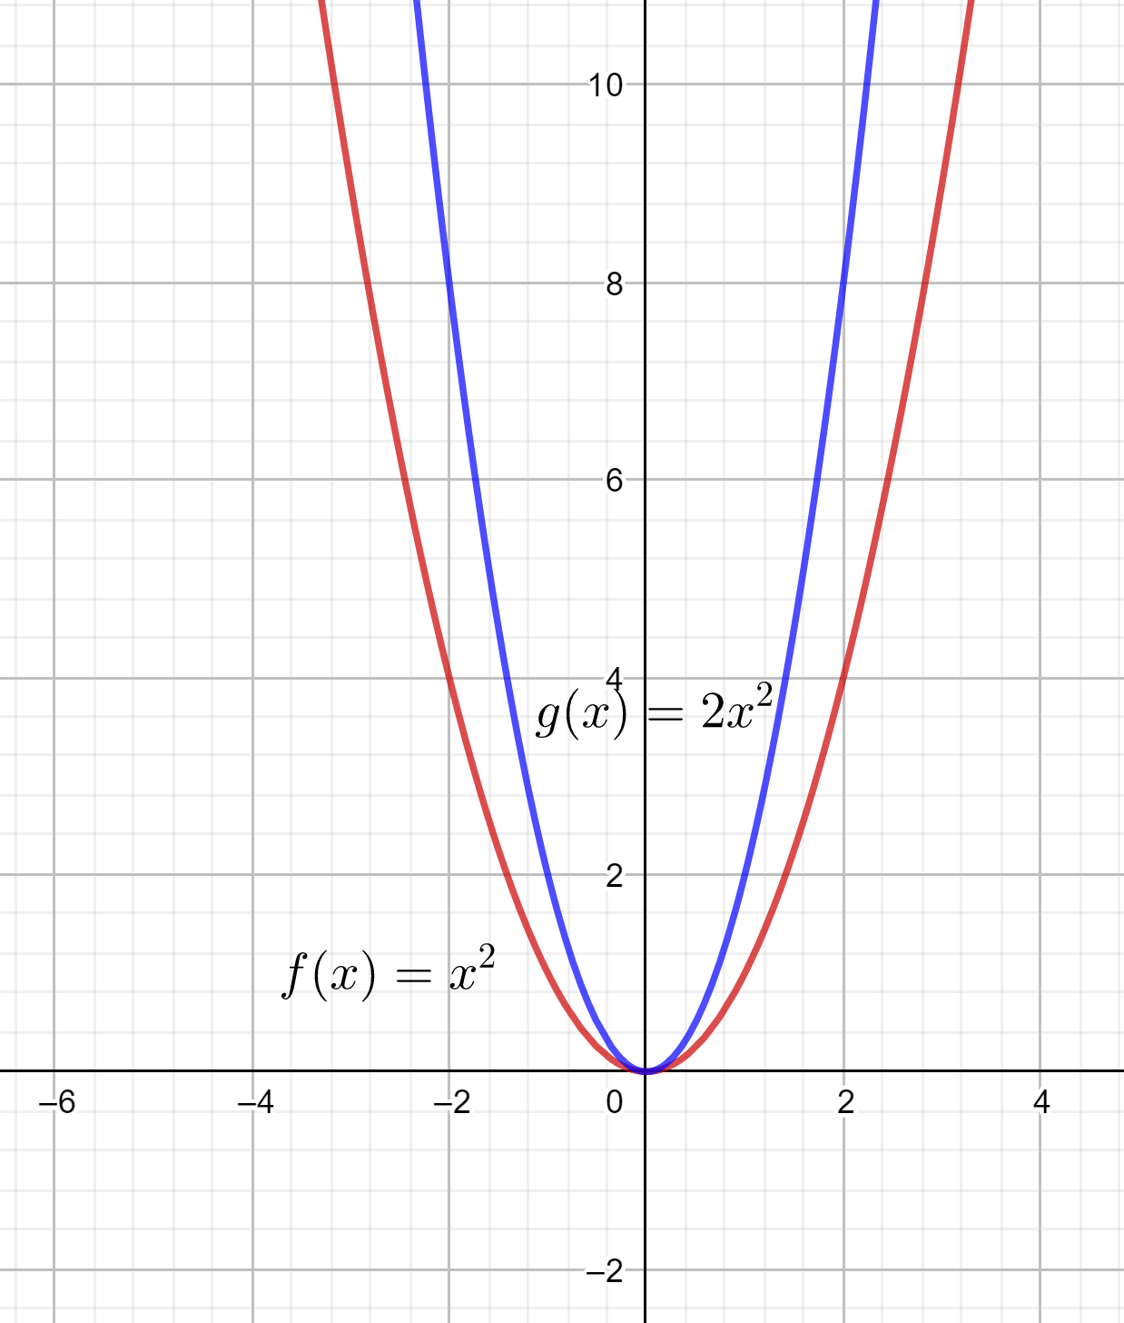
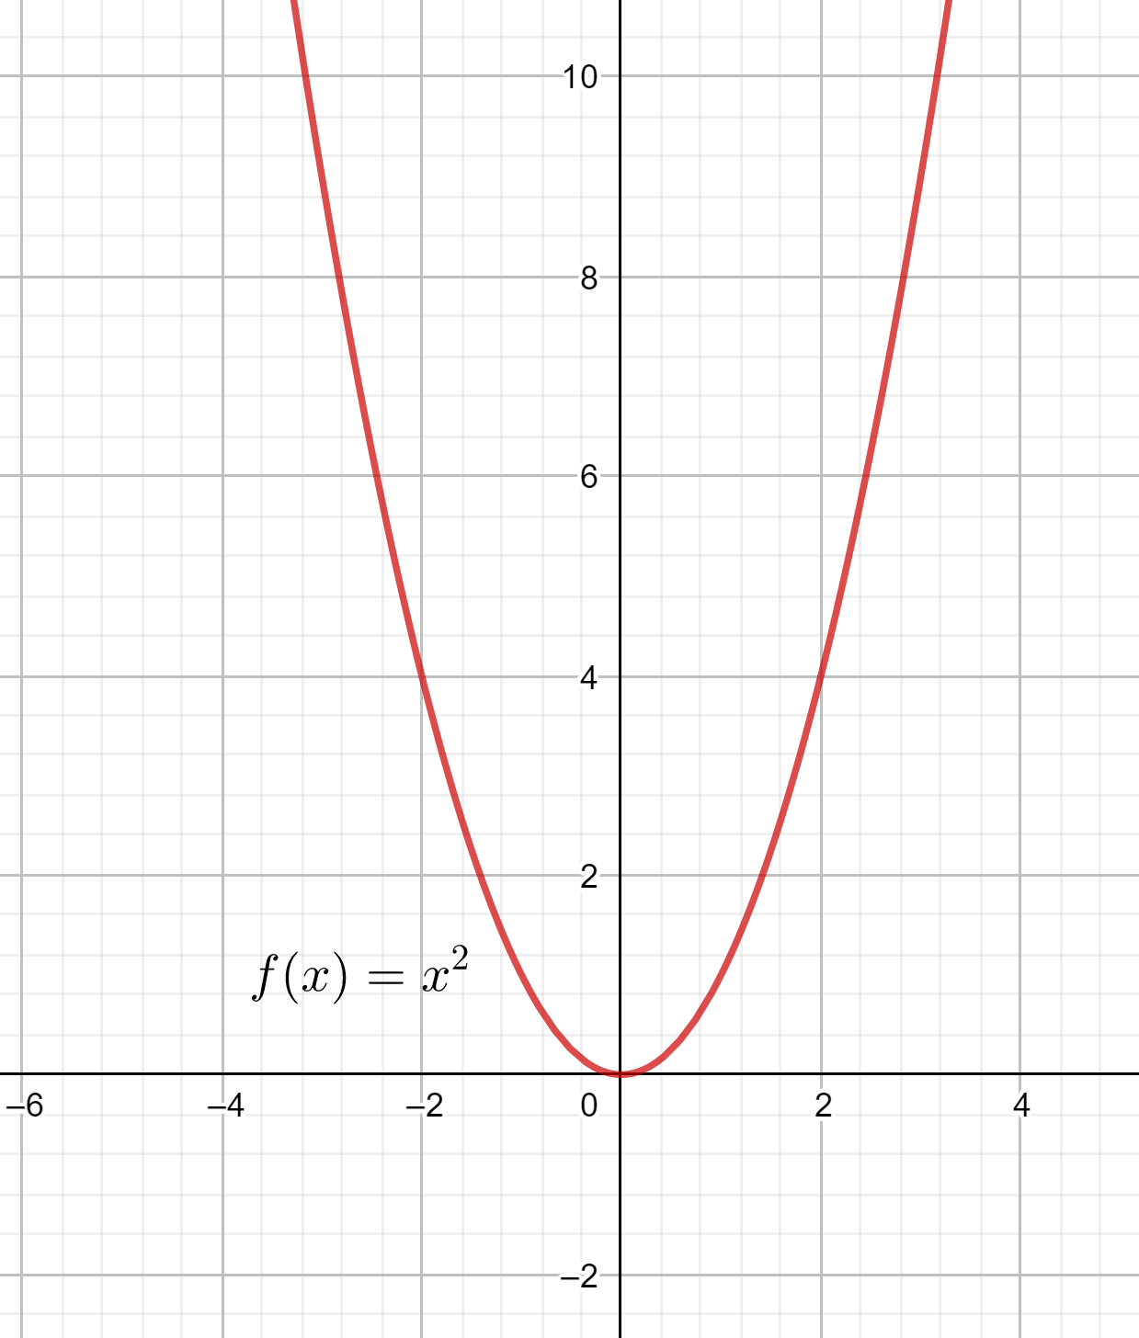
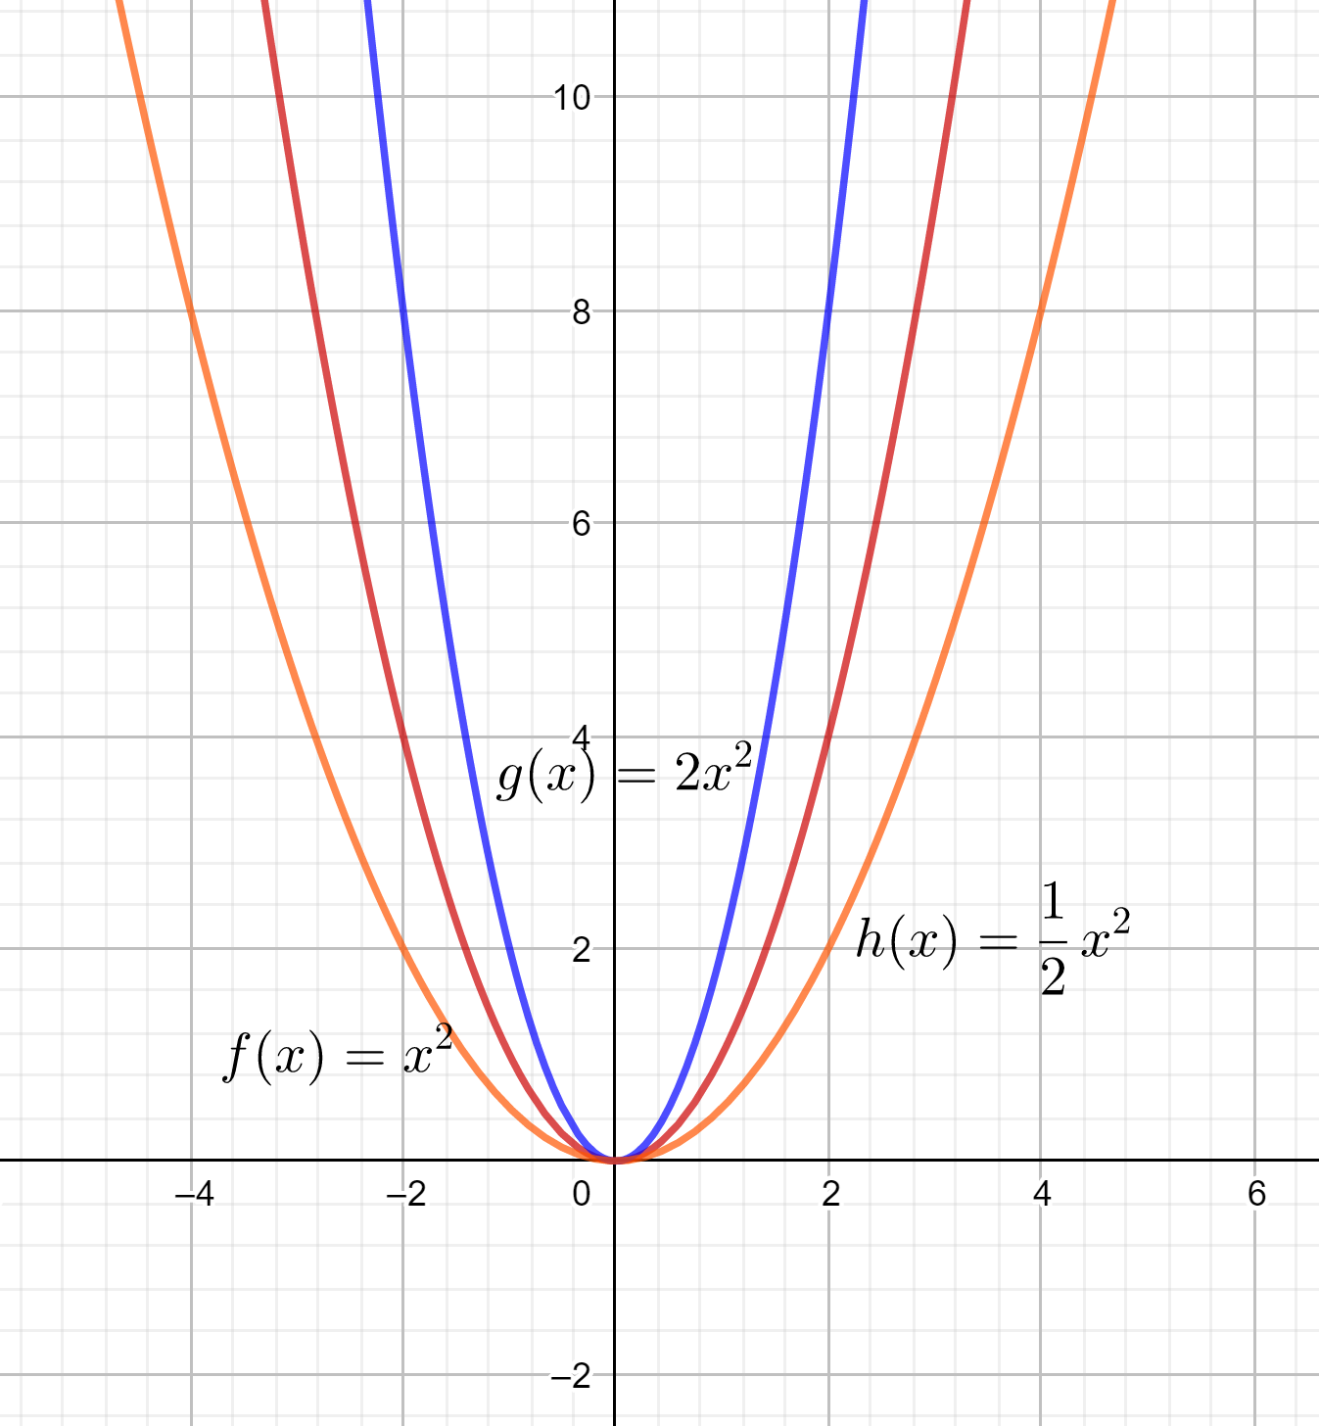

$$y=a.f(x)$$
Conclusion:
The graph of $y=a.f\left(x\right)$ can be obtained by :

Slide 8
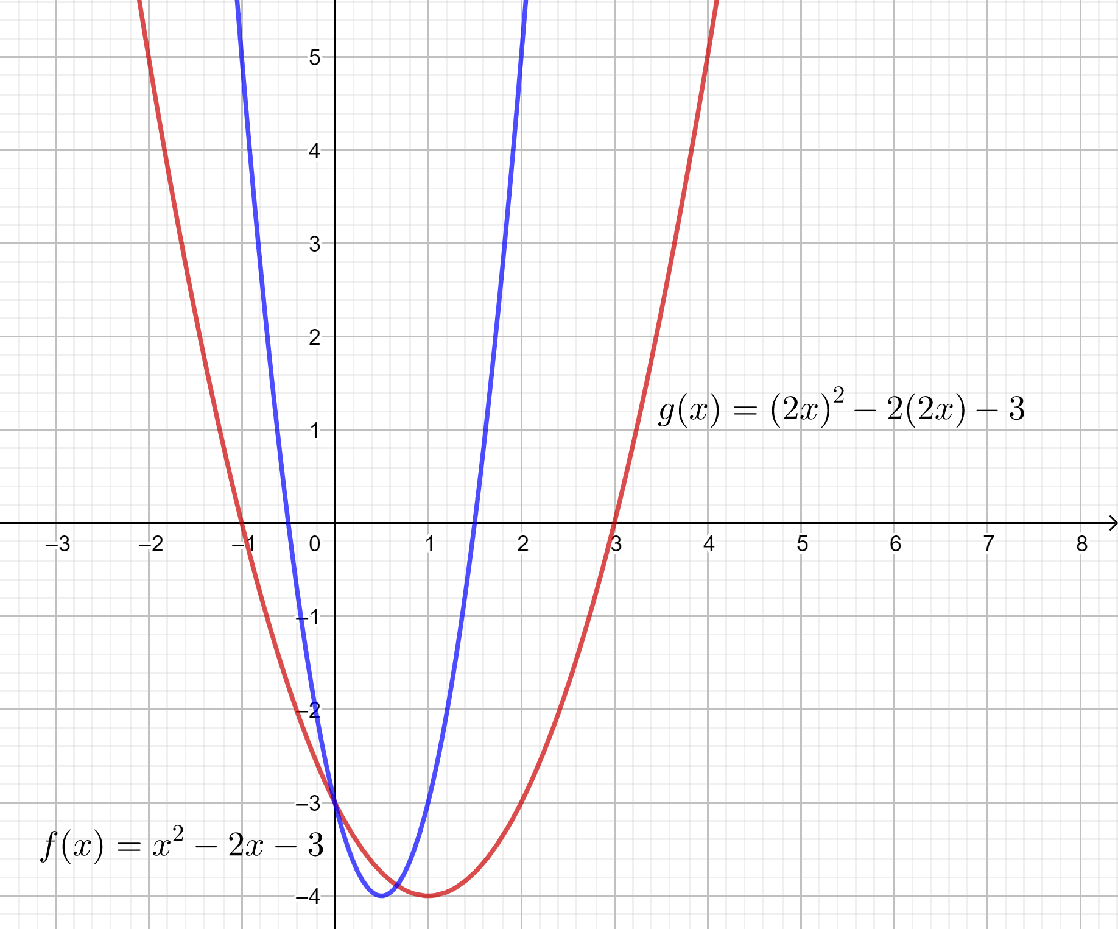
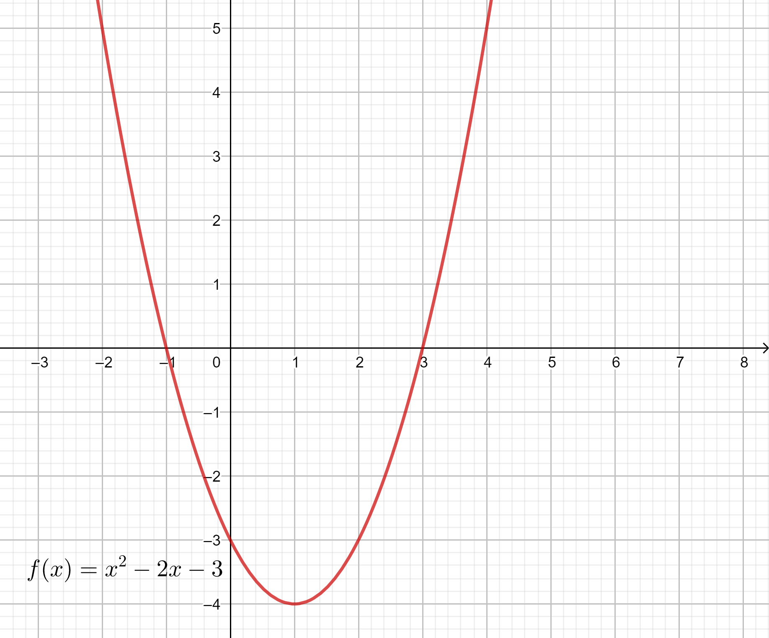

$$y=f(ax)$$
Conclusion:
The graph of $y=f\left(ax\right)$ can be obtained by :

